Slide 1
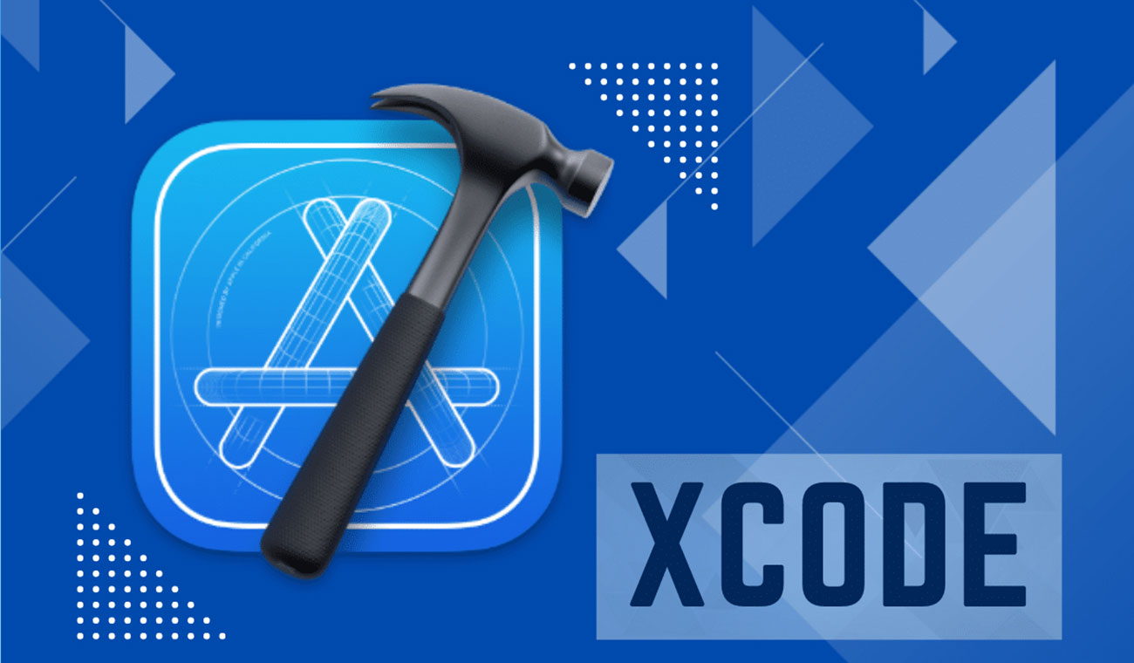

Slide 2
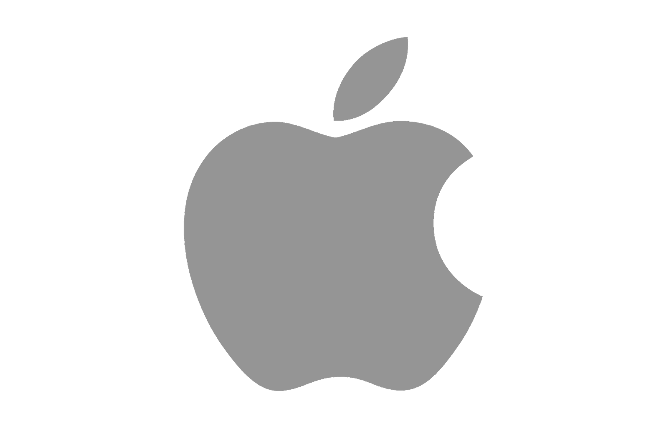


Introduction
Official Apple’s IDE
Created in 2003, often updated
Swift, Objective C, C, C++

Slide 3
Uses
Development for Apple’s ecosystem apps
Full application creation
Debugging
Integrated simulator
Git integrated
Publish on the App Store integrated

Slide 4
Graphical User Interface (GUI)

Slide 5
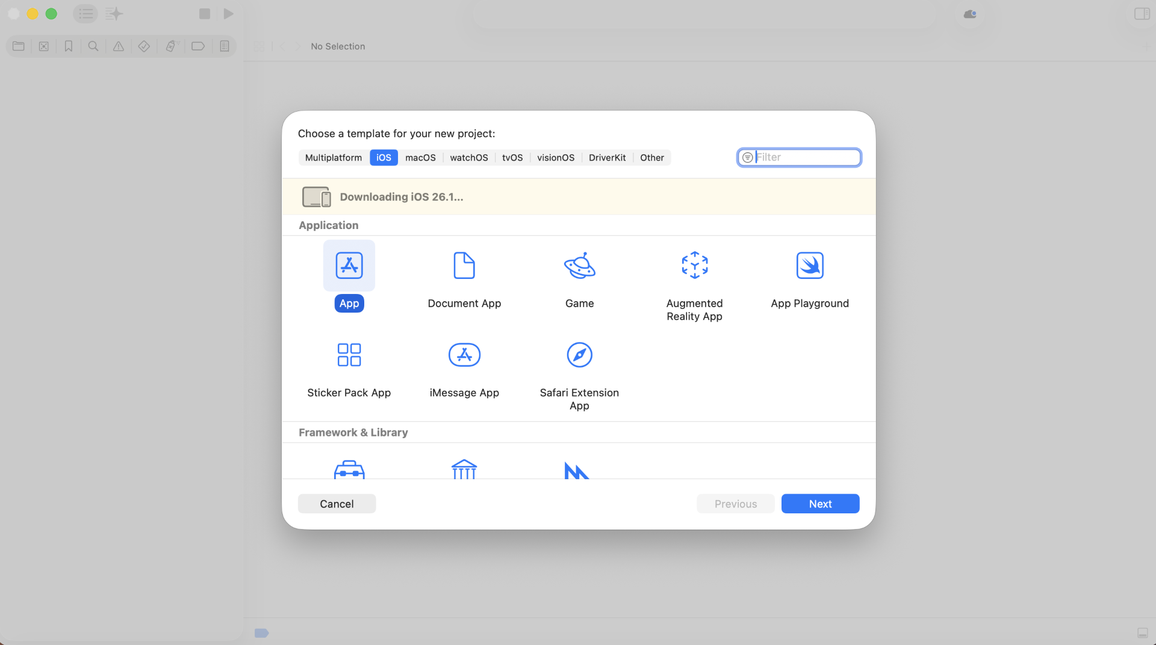

Slide 6
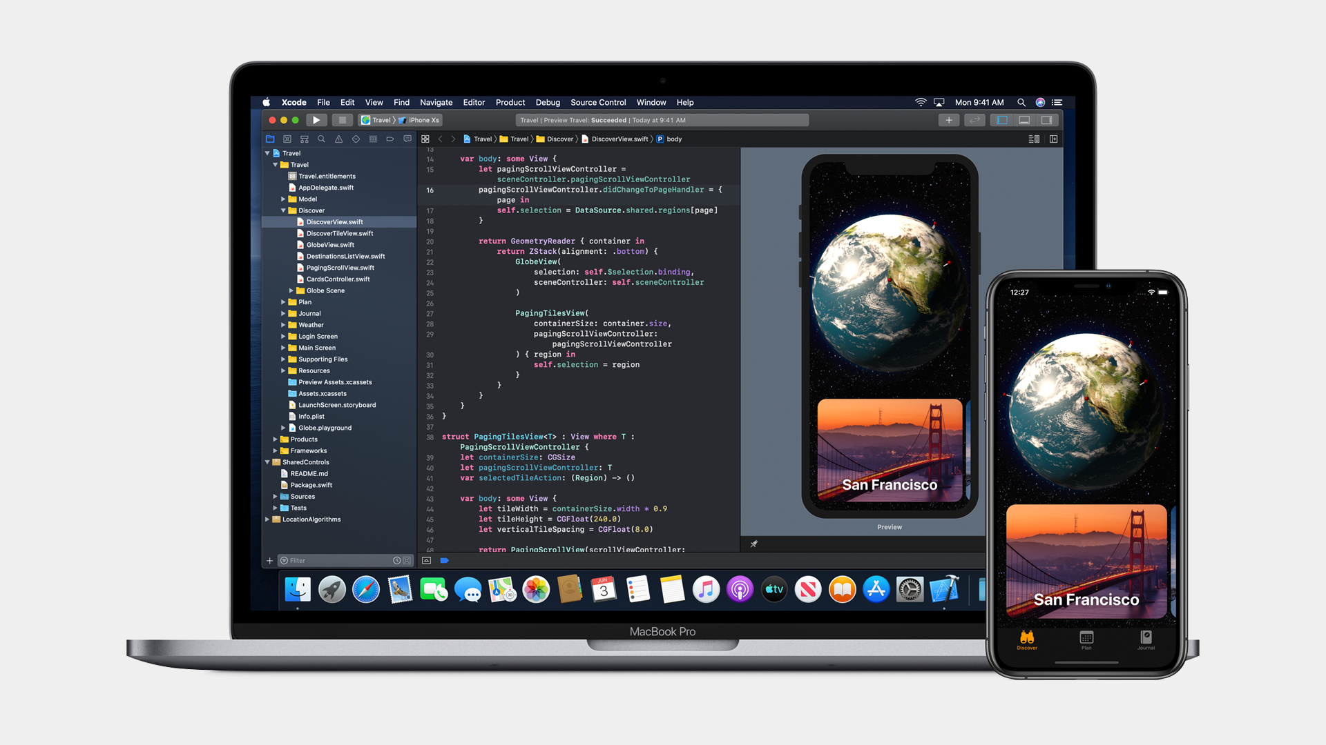

Slide 7
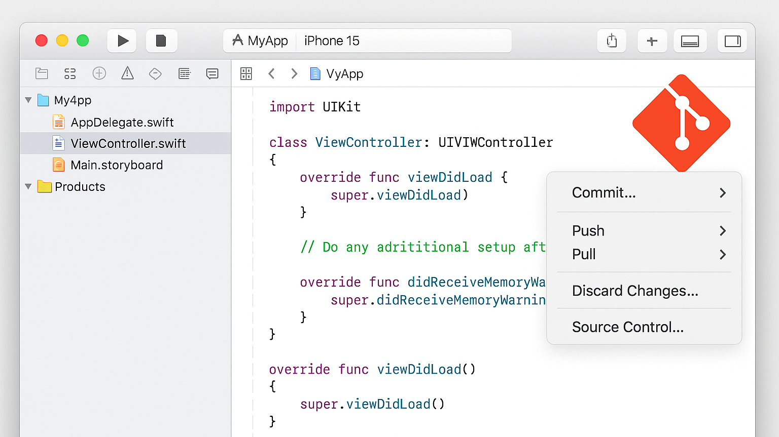

Slide 8
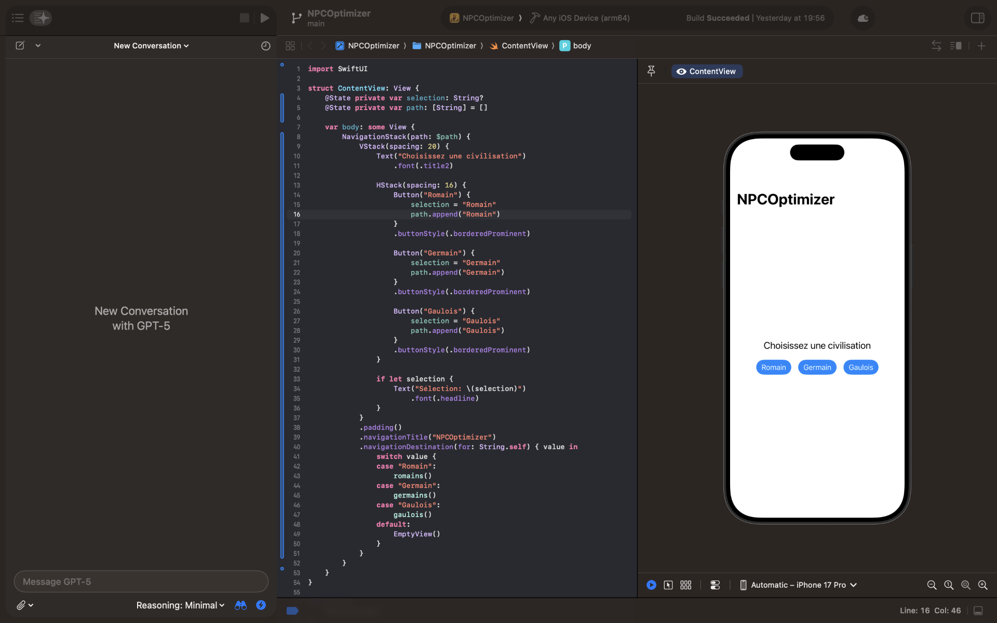

Slide 9
Any question ? Feel free to ask

